Slide 1
Web Scale collaboration and Crisis Management
François Charoy - @charoy
Inria/University of Lorraine
EQUIPE PROJET
Coast
CENTRE Inria
Nancy Grand Est
02/09/2015

Slide 2
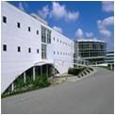
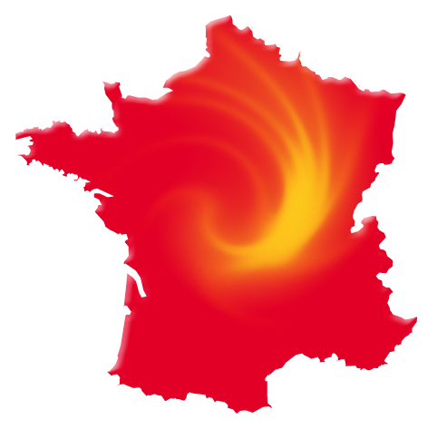
Coast Team
Inria/LORIA research team (15/20 people)
University of Lorraine
Research topic :
Web Scale trustworthy collaborative systems
team.inria.fr/coast
@InriaLORIACoast
Inria NANCY
Grand Est

Slide 3
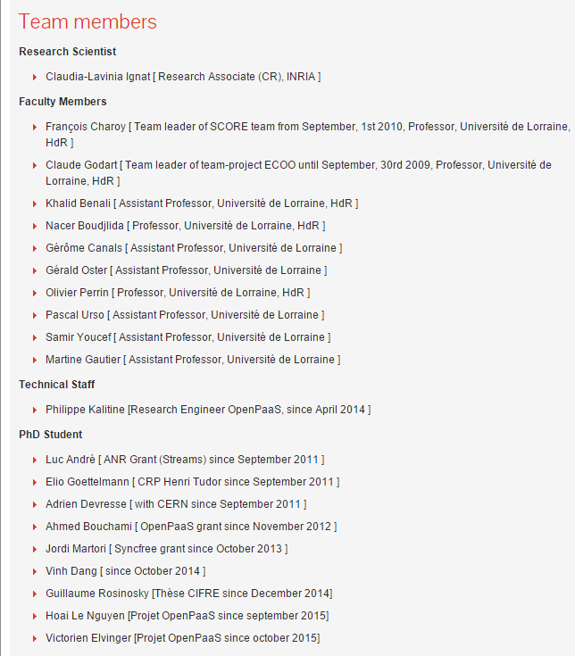

Slide 4
Goals of the presentation
Identify specific requirements for collaborative systems in Crisis management
Introduce some current results and research challenges
Introduce a new partner : the crowd

Slide 5
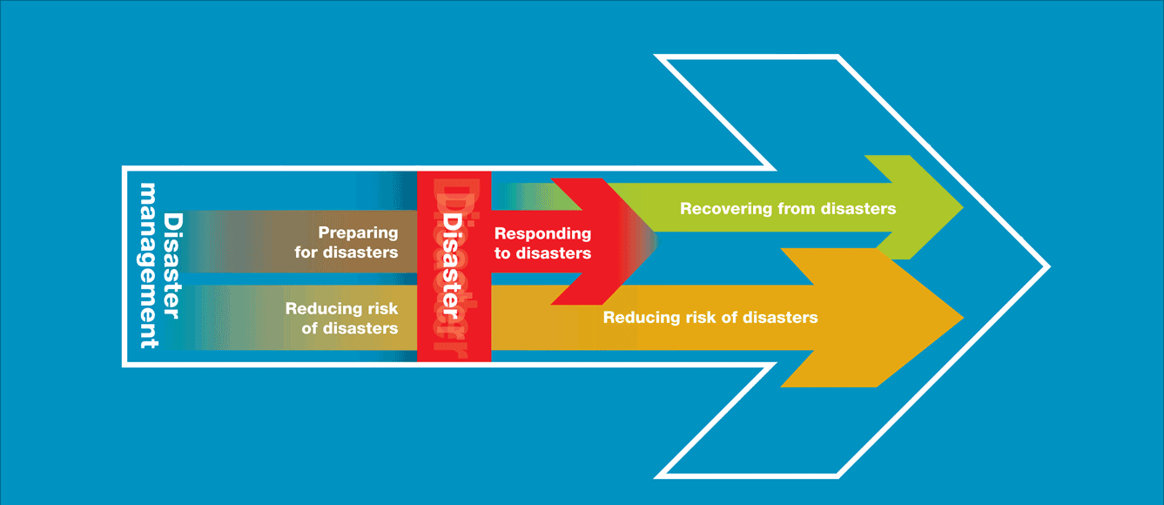
Disaster management phases
http://www.ifrc.org/en/what-we-do/disaster-management/about-disaster-management/

Slide 6
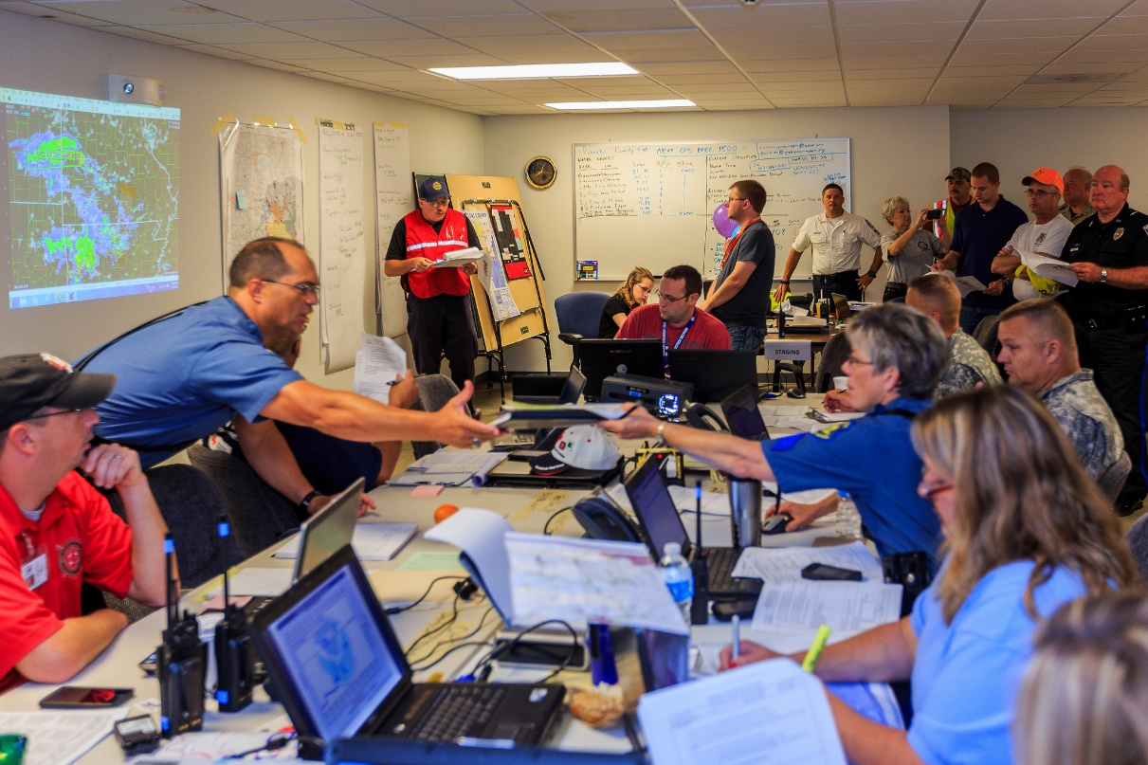
Emergency management organisation
Multi-organisational :
  Security organisations,
  Health care organisation,
  Safety organisations,
  Government organisations
Centralised coordination
Hierarchical

Slide 7
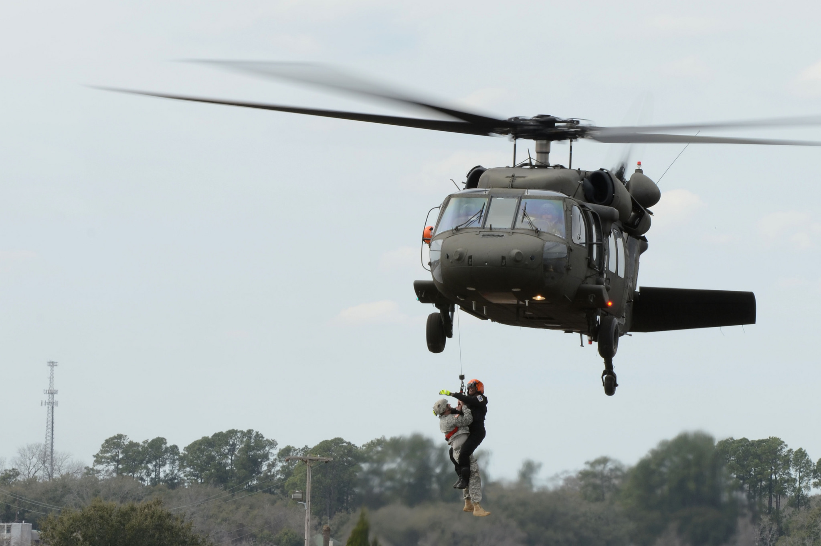
Collaboration partners
Traditional actors
  Police,
  Firefighters,
  Healthcare, Hospitals,
  Civil Security,
  Military,
  Red Cross,
  Local Civil servants…
Ad-Hoc actors
  Industry worker,
  transportation workers
  Other GNOs
Notes:
Training/Preparation is not so common for more traditional virtual organisations. They build on previous experience of collaboration. Still this is something we can do in university, learning people to collaborate

Slide 8
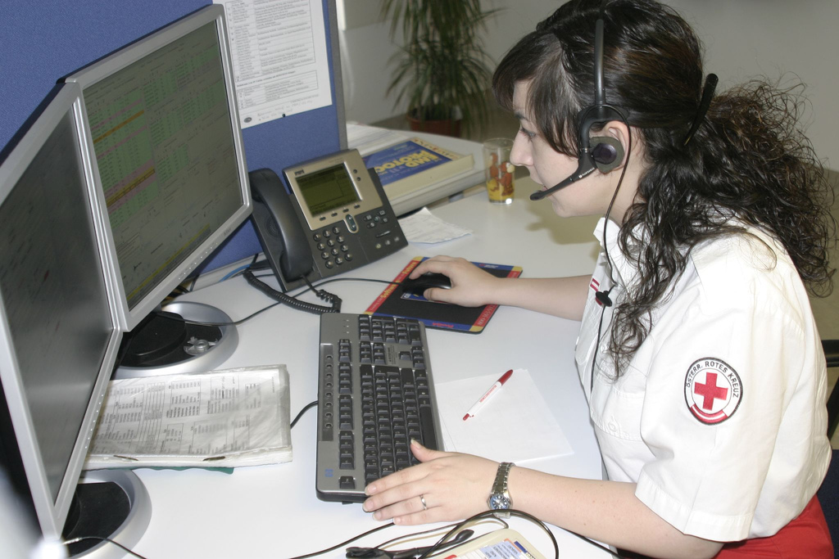
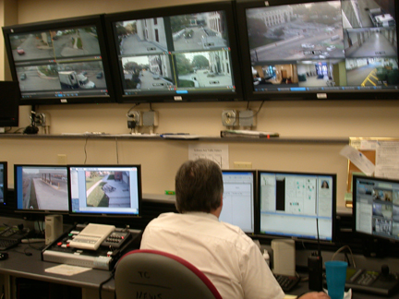
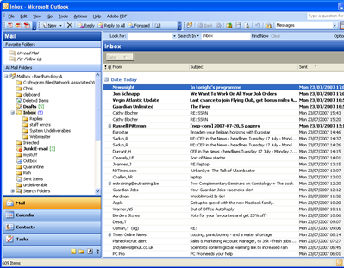
They collaborate with
Email
Phone
Radio
Other ICT Tools

Slide 9
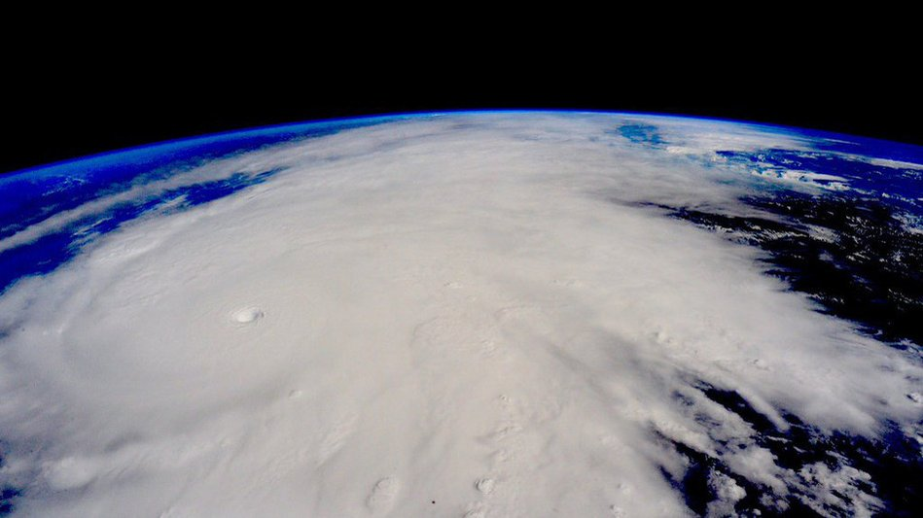
When the scale increases
Across borders
Across organisations
Across cultures
Across interests
Cluttered by
  Political and legal issues
  Limited resources
  Interoperability issues
It becomes messy

Slide 10
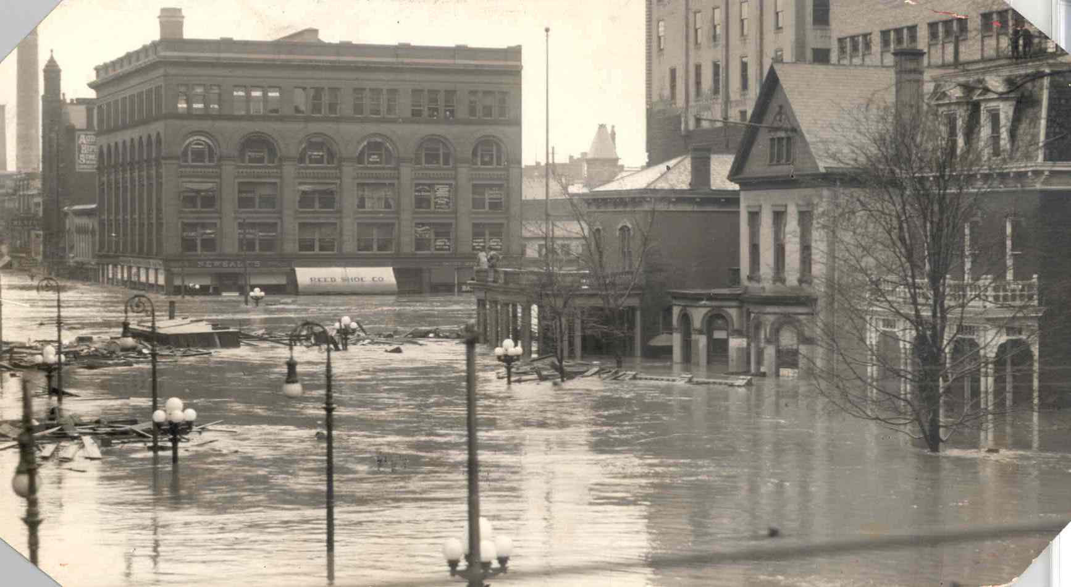
Variation in crisis
Crisis management is an evolving matter
Recent crisis have obliged to revise the preconceived view on crisis management
  From a technical point of view
  From a sociological point of view

Slide 11
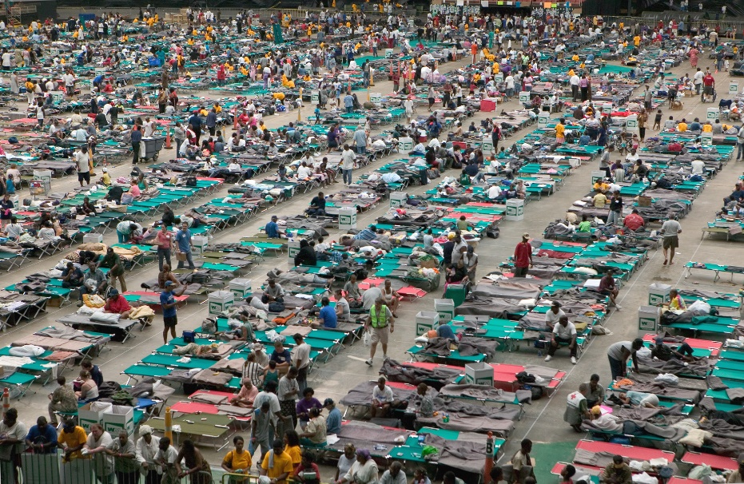
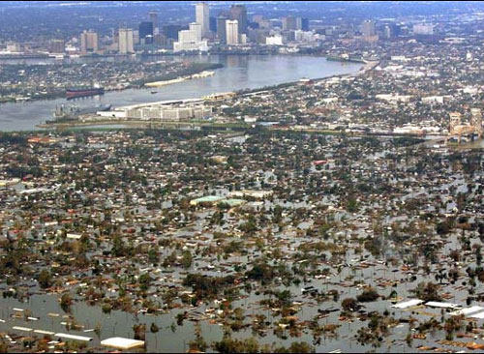
Hurricane Katrina 2005
Category 5 Hurricane
Caused breaches to flood protections structures
80% of the city of New Orleans Submerged (1500 deaths)
Notes:
This event

Slide 12
Coordination issues
Very wide area affected
Several political decision levels
Lack of preparedness
Coordination issues during the evacuation
“Some teams displayed their own initiative [..]
Unfortunately, [..] rescuers were forced to leave people on highways [..] in continuing need of transportation, food, and water.”
(White House Report / Hurricane Katrina)

Slide 13
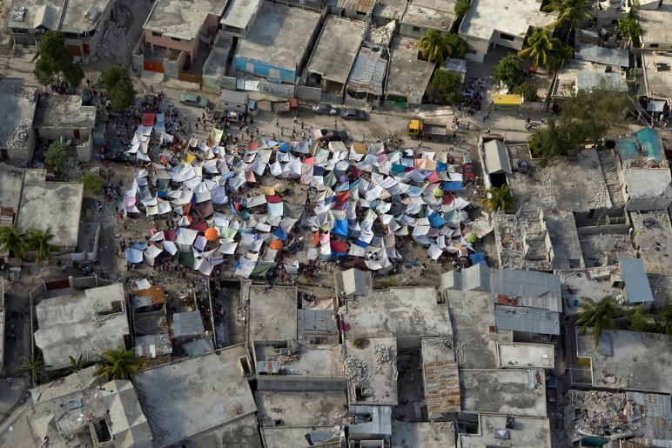
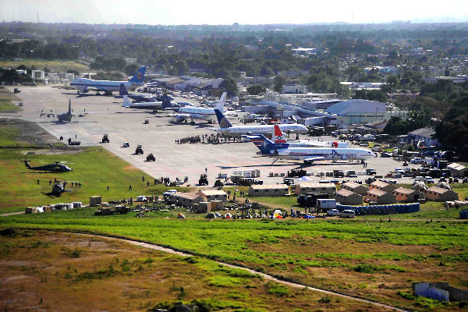
Haiti Earthquake 2006
7.0 Magnitude earthquake – 3.5M people affected – 220.000 death (est.)
Hundreds of responding organisations

Slide 14
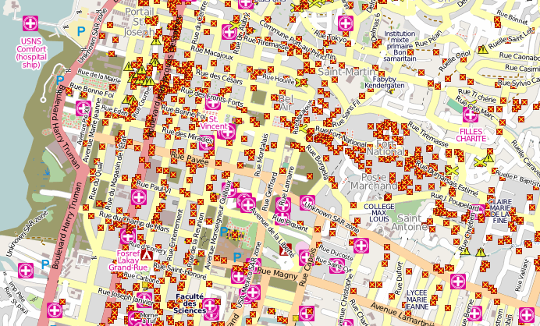
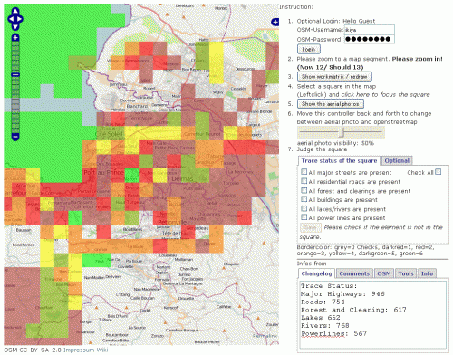
Unexpected event at an unexpected scale
First responder : people
Overwhelming answer from the international community (hundreds of NGO’s)
First important use of social network
volunteer based crisis mapping
http://www.digital-humanitarians.com/
Notes:
Spontaneous collaborative network of people jon to create an accurate map of Port au Prince with volunteers collecting and verifying informations. It has been recognized by the traditional organisation as a very valuable and helpful initiative. And now, there are task forces ready to help online.

Slide 15

Collaboration Challenges
Social
Organisational
Technical
Trust
Security
Safety
Interoperability
Culture
Scalability
Sharing and coordinating actions

Slide 16
Sharing informations
Collaboration requires
  To be able to share information
    Effectively
    At a large scale
  To preserve privacy
  To trust the collaborators
  To control the data distribution
What do we share
Documents
Calendars
Maps
Contacts
Plans
…

Slide 17
Sharing with replication
Reliability
  Possible to continue working when a replica crashes
  Better protection against corrupted data
Performance
  Scaling in numbers
  Scaling with the size of a geographical area
Challenge: how to maintain consistency between replicated data ?
Notes:
Protection against corrupted data – if there are 3 copies of a file and every read and write operation is performed on each copy. We can protect against a single, failing write operation by considering the value returned by at least two copies as being the correct one.
Scaling in numbers – when an increasing number of processes want to access data managed by a single server. Performance can be improved by replicating the server and dividing the work.
Scaling with the size of a geographical area – placing a copy in the proximity of a process using them, the time to access the data decreases.
Challenge: if a copy is modified, the others become inconsistent

Slide 18

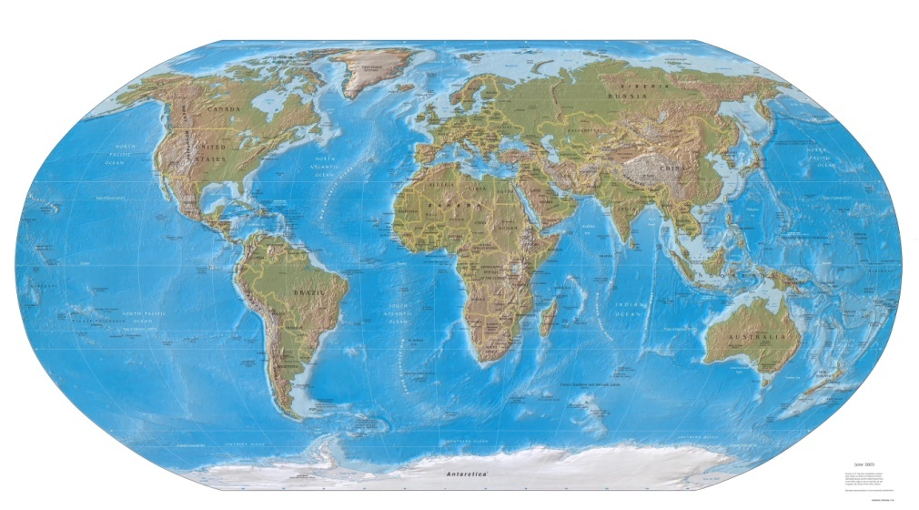







Real-time Collaborative Editing Applications
Collaborative activities:
  Report writing
  Transcription (lectures, movie subtitles)
  Translation
  Note-taking during events
  Existing solutions:
  GoogleDocs, Office365, Etherpad, Real-time editors for Wikis (XWiki)
. . .

Slide 19
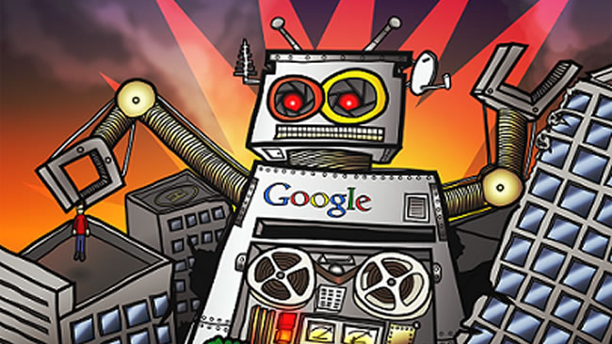

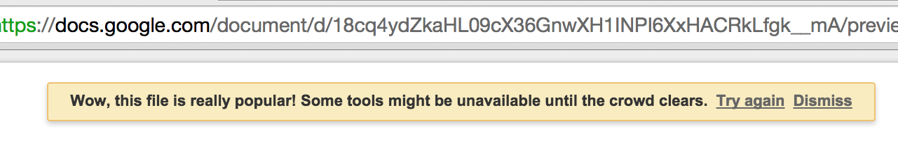
Limitations of RT Collaborative Technologies
Centralized control
Scalability issues (e.g. GoogleDocs 50 users sharing limit)
Privacy issues
Notes:
https://support.google.com/drive/answer/2494827?hl=fr

Slide 20
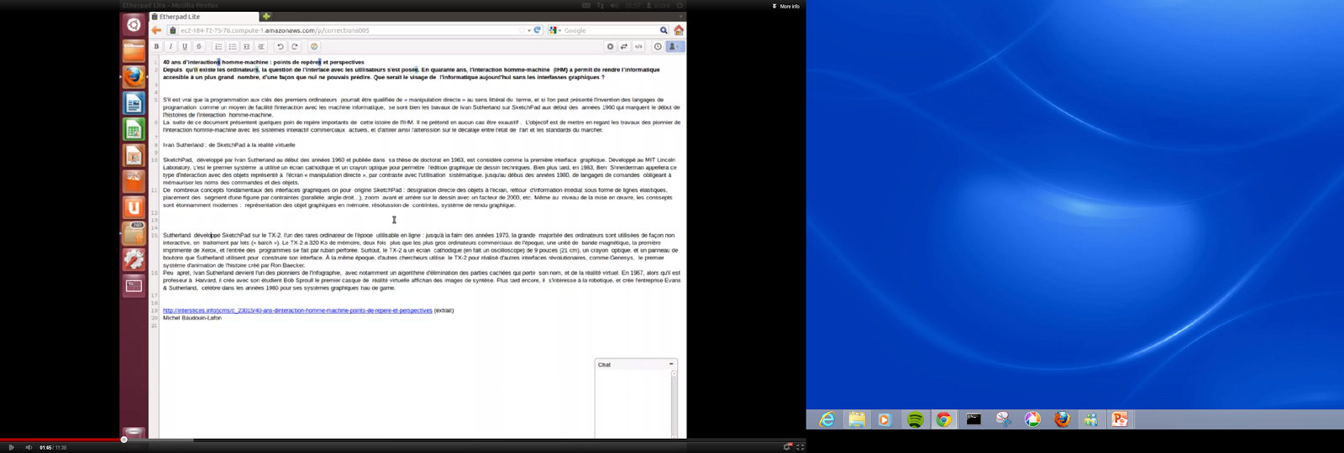
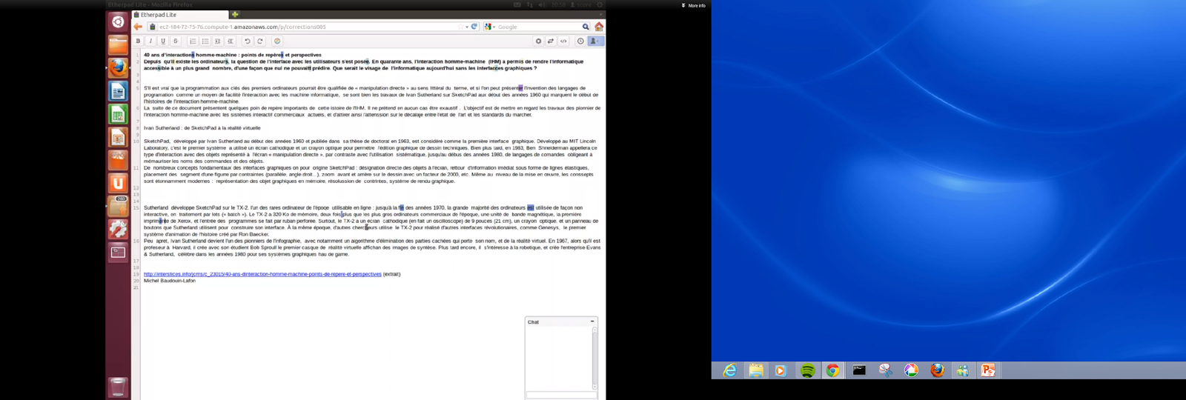
Conflicts management
How to avoid them when the number of users grows
pouvais
interfasses
pouvaitt
interfacces

Slide 21
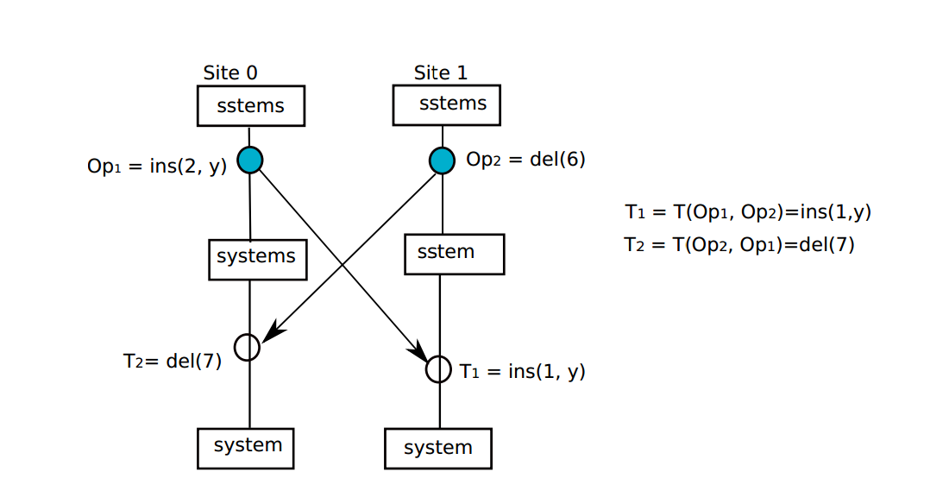
Optimistic replication and Collaborative editing

Slide 22
Testing scalability in GoogleDocs/MUTE
Simulations
  Simulate users that type simultaneously on shared document
  Simulate different typing speeds
    Fast groups: 40 wpm
    Moderate groups: 35 wpm
    Slow groups: 23 wpm
    1wpm=5cpm
    => 2-4 cps

Slide 23
Delays in GoogleDocs
Typing speed:
2 chars/sec

Slide 24

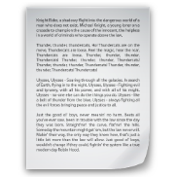







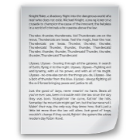
Traditional centralized architecture
Who control the server
Notes:
Privacy/Control issues
Who control the server ?

Slide 25
Naive p2p Architecture
Notes:
Everybody shares with everybody – again non control

Slide 26
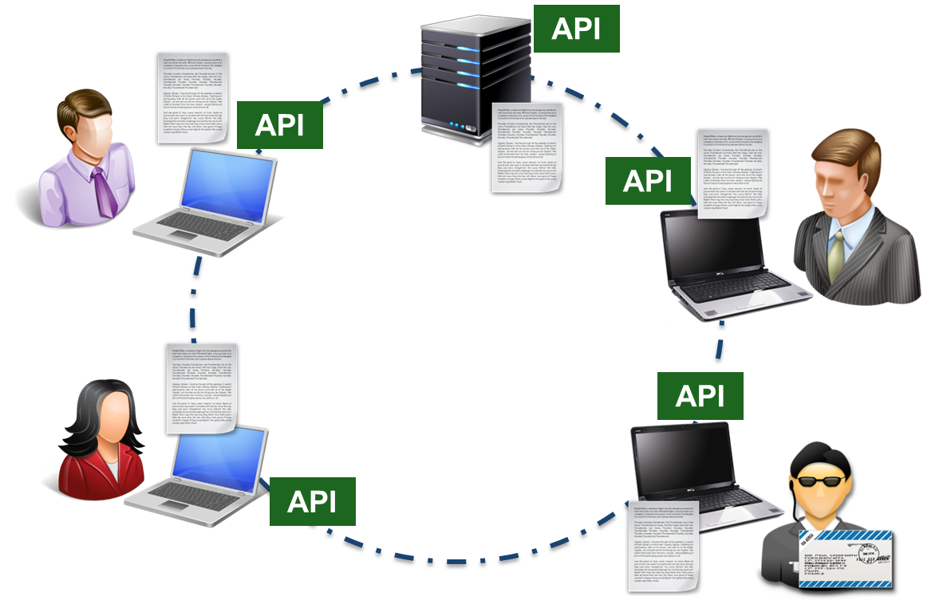

Abstract/Configurable p2p architecture
Decide of the topology and the contracts
Notes:
A transport API hide the underlying network and allows to control it to set up all kind of coordination

Slide 27
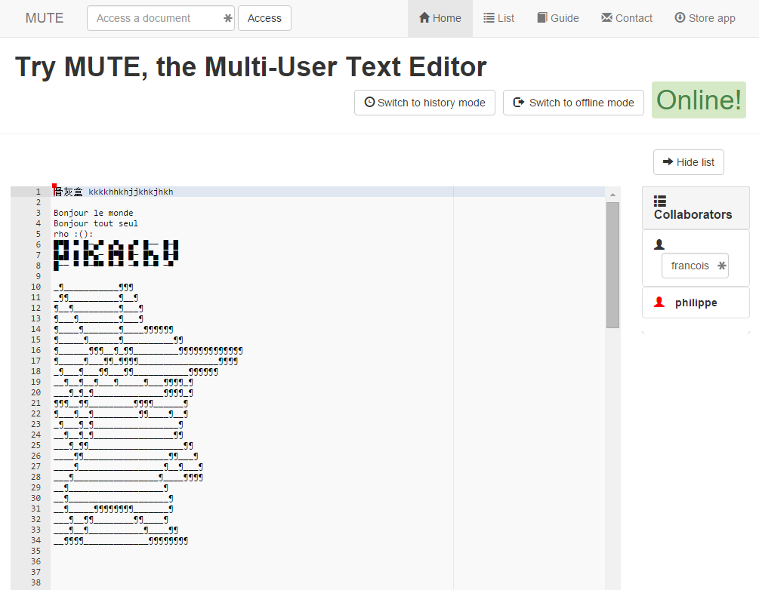
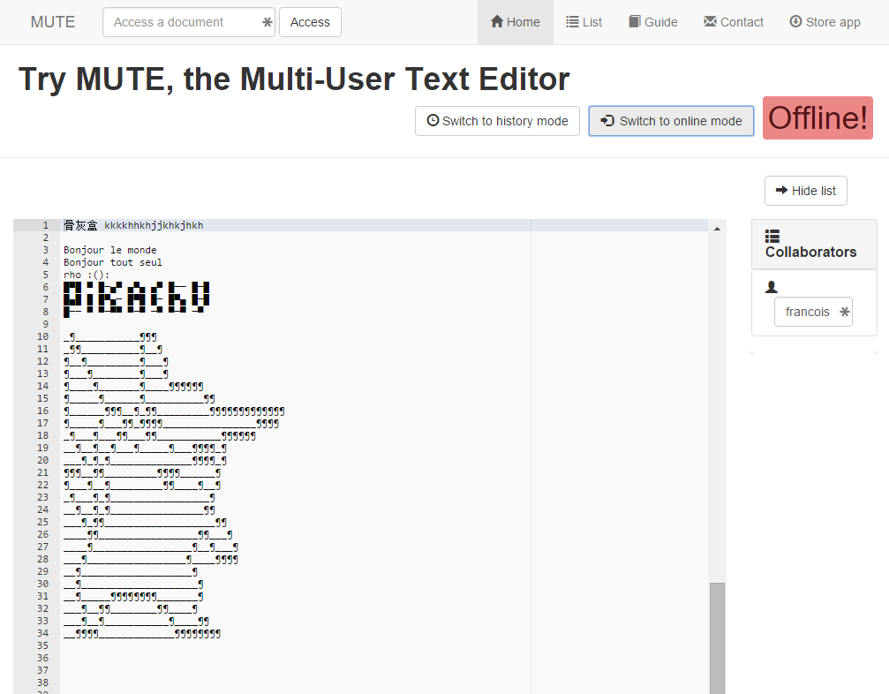
The Mute P2P editor
Based on CRDT Algorithm (p2p)
http://mute-editorcrdt.rhcloud.com/

Slide 28
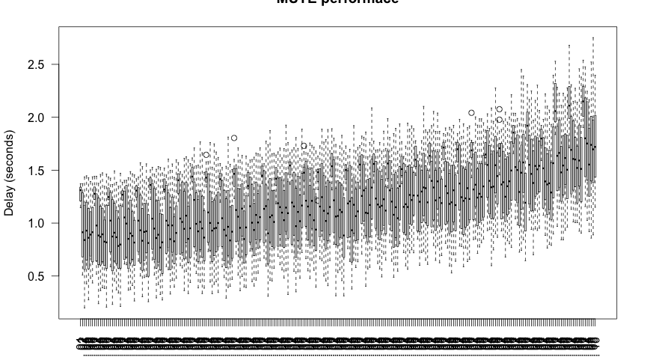
Delays in MUTE
Max. no of users: 50
Typing frequency: 1-10 chars/s

Slide 29



Hybrid collaboration between organisations
Centralised inside organisations/ p2p between organisations
Sharing Contract
Notes:
Autorisation are managed locally

Slide 30
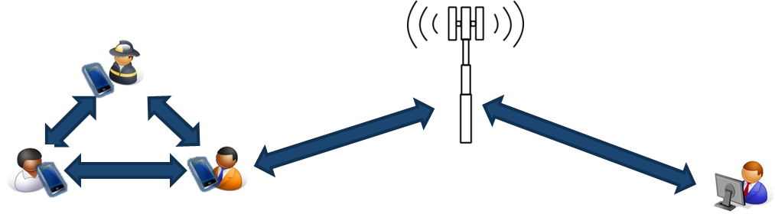
Ad-Hoc collaboration on the field
P2p collaboration between people regardless of organisations
MUTE P2P Editor

Slide 31




Web based ad-hoc collaboration
1
Reconnexion
2

Slide 32

Collaboration Man/Service
Document Service
(translation,compilation)
Storage Service (Drive/Github)

Slide 33




Secure distributed collaboration
Future Work
Collaboration data can be encrypted and not shared on the cloud (being investigated).
Provides guarantees to the participants

Slide 34
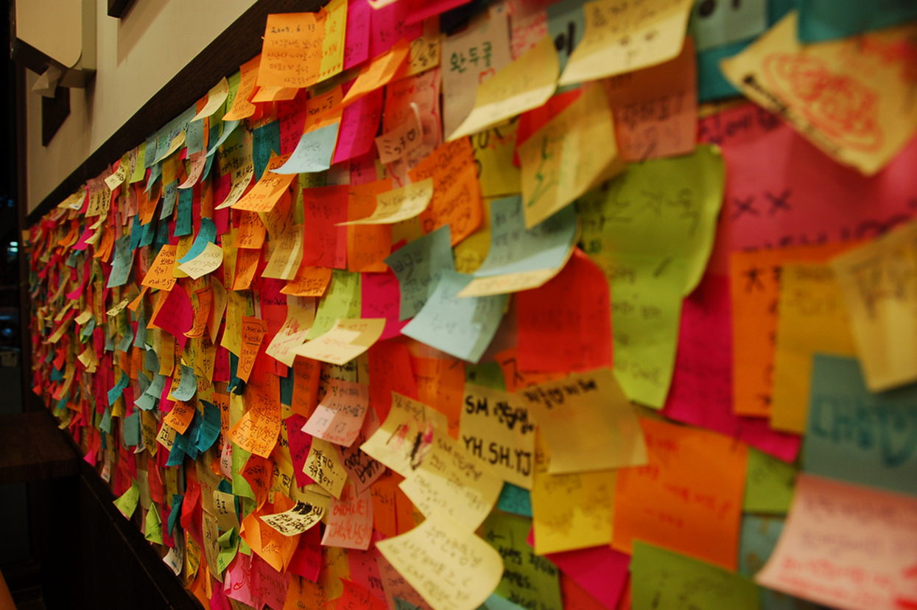
Coordinating actions
Coordination between organisation is a cornerstone of large scale collaboration.
Important questions
  Who governs the coordination ?
  Who owns the process ?
  Who design the process ?
  Who control the process ?

Slide 35
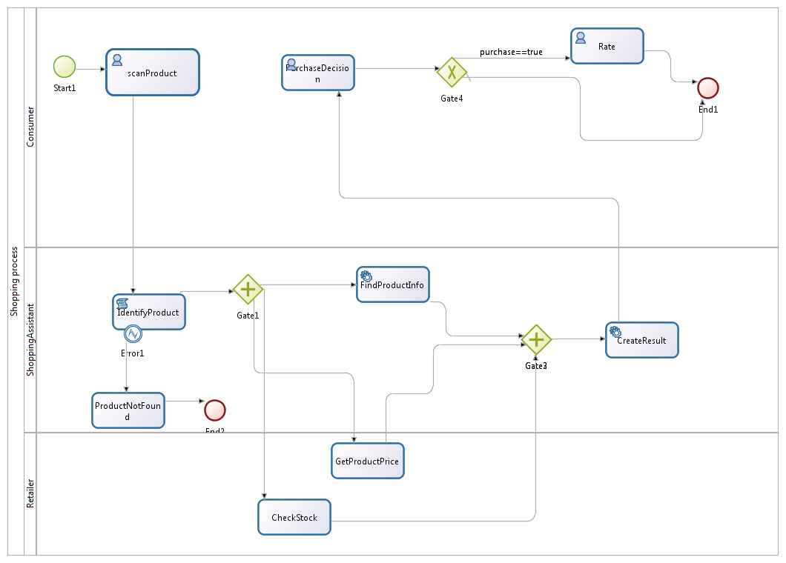
BPM and Crisis Management
Business Process Management/Workflow Systems have been suggested for emergency management
do they work for disaster management?

Slide 36
The answer is no/not really/probably not
Outcome of a workshop with Firefighters
Notes:
The process that were produced were very complex and would not support very well escalation – And more than that would not support very well interorganisational coordination, especially when the networ is not known in advance

Slide 37
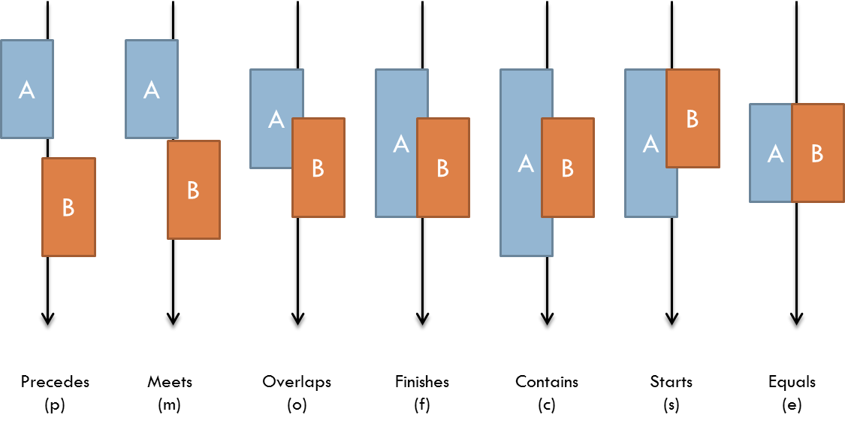
Four principles
The model has to be dynamic
Design time = Execution time
Dependencies requires flexibility
No one should own all the control
Allen Temporal dependencies

Slide 38
Activity and dependency
Transport People
Temporal Dependency
Search People
Plan
Plan
Execute
Execute
Idle
Finish
Failed
Finish
Failed
Activity
Activity

Slide 39
Activity and governance
Role (User assignment to this role is part of the activity)
Transition
State of Manage-ment Lifecycle

Slide 40





Inter organisational issues
“we are exchanging text information real-time through either cell or mobile units or satellite”
[..]
“obvious the more complex a situation gets, for instance where you may have many organizations working collectively in order to accomplish a goal, but at the same time working independently in terms of their own interests, where you get in those in situation like that, you know it get to the point, to be so complex that it would be overwhelming”
Fire Fighter, Hamilton, MT

Slide 41
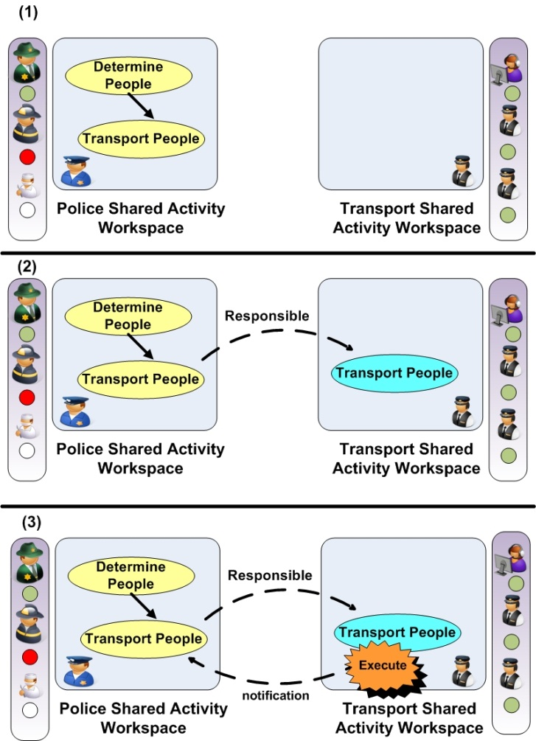
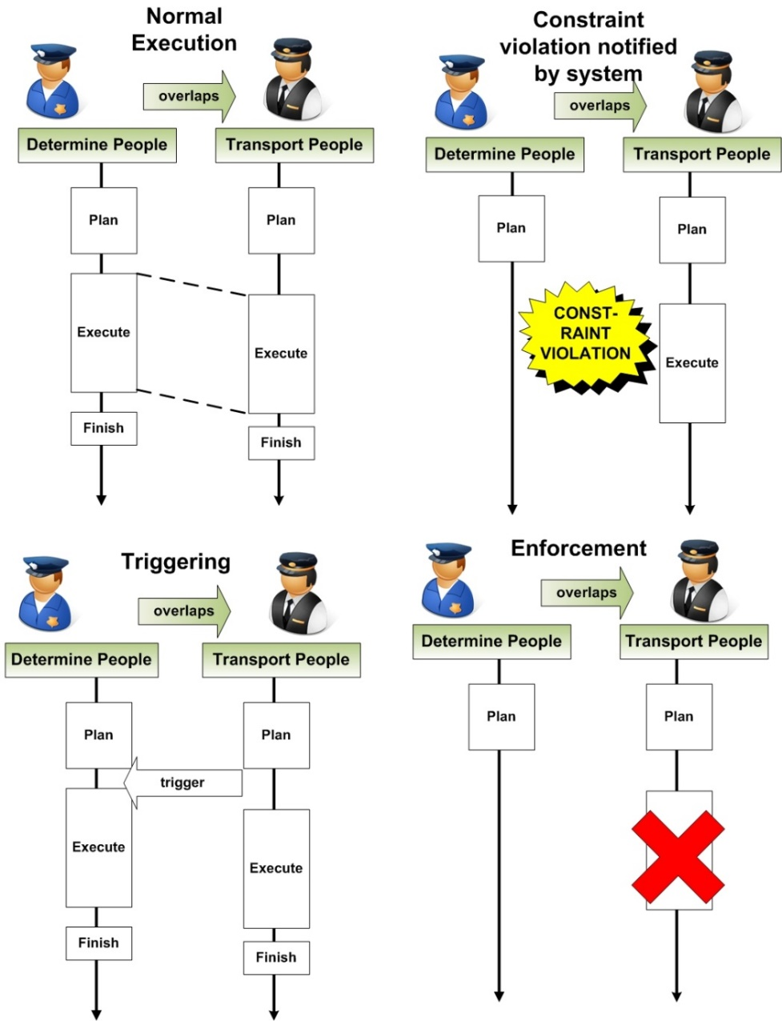
Coordination problem awareness

Slide 42
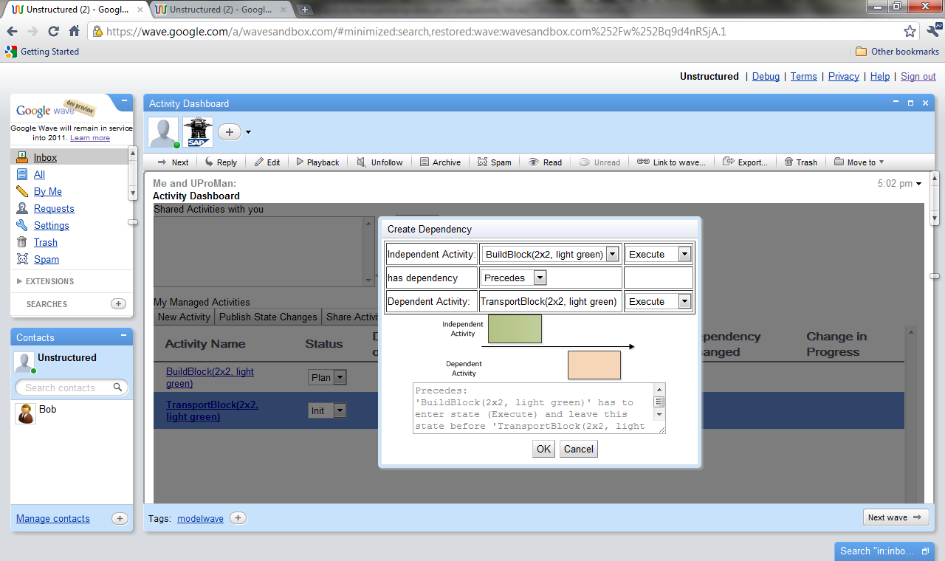
Implementation on Google Wave

Slide 43
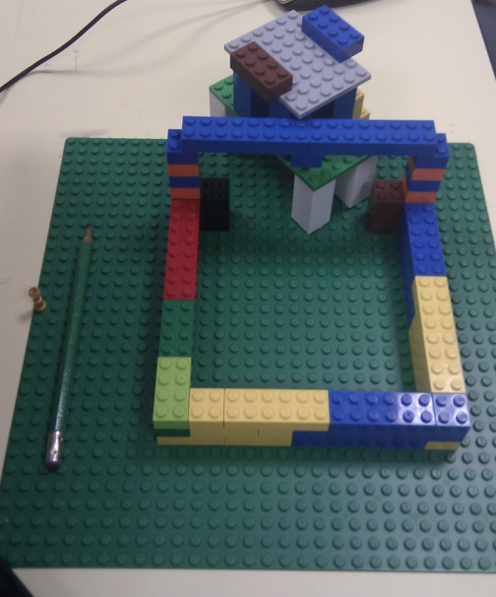
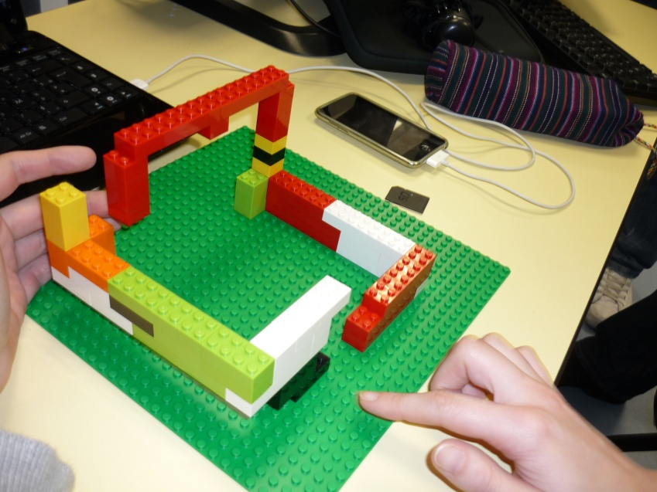
Experimentation
How to validate the model ?
Crisis are difficult to replicate
Very few crisis management exercises

Slide 44
A new partner for crisis management: the citizen
A challenge for traditional response organisation
They are the first responders
They have sophisticated communication tools
They have volunteers all over the world
It’s simple but it’s challenging

Slide 45

International and official recognition
Since Haiti the role of social media and of digital volunteers is recognised
Ushahidi
Digital Humanitarians
Visov (French organisation)
…
But…

Slide 46
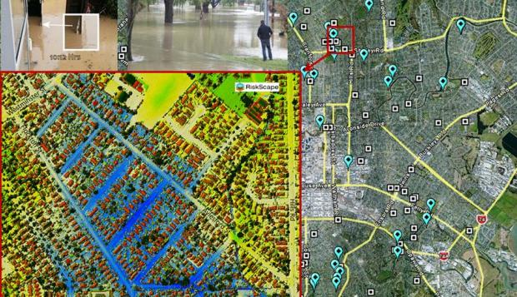
Photos help NIWA map Christchurch flood
Updating a flood map
Citizen + expert coordination
Manual execution
http://tvnz.co.nz/national-news/photos-christchurch-floods-help-plan-future-video-5870548

Slide 47
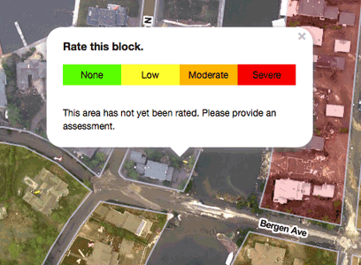
Sandy Damage Assessment
Crowdsourcing satellite pictures
Results with short term validity

Slide 48
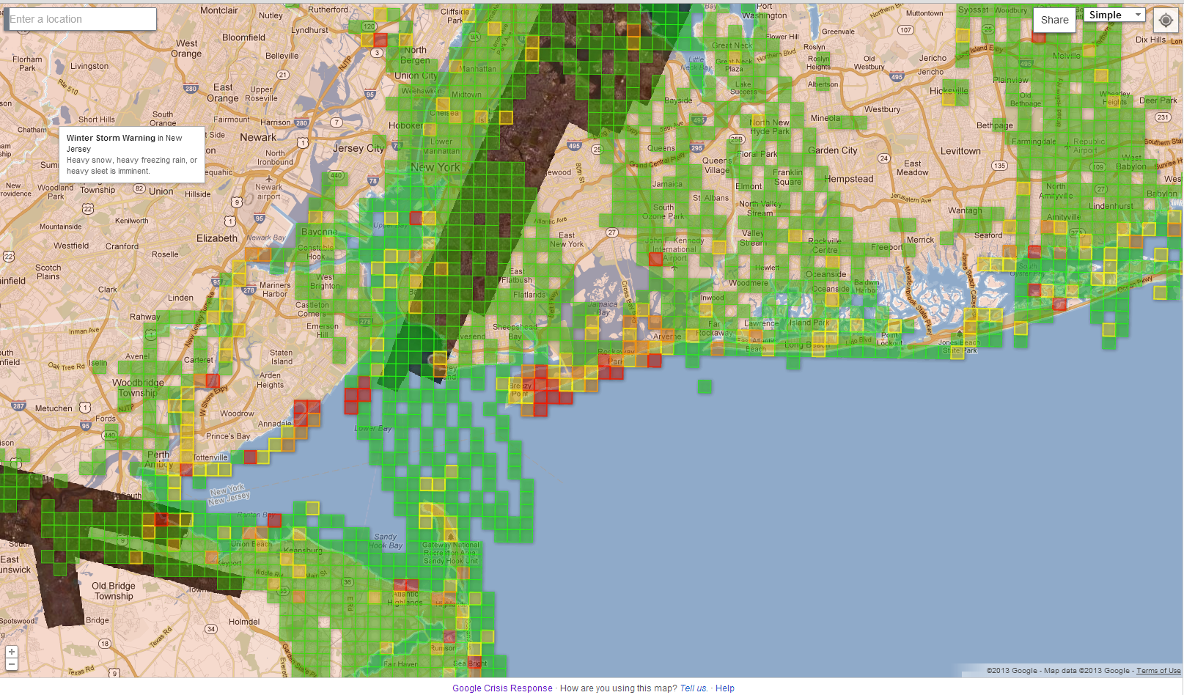
Sandy Map

Slide 49
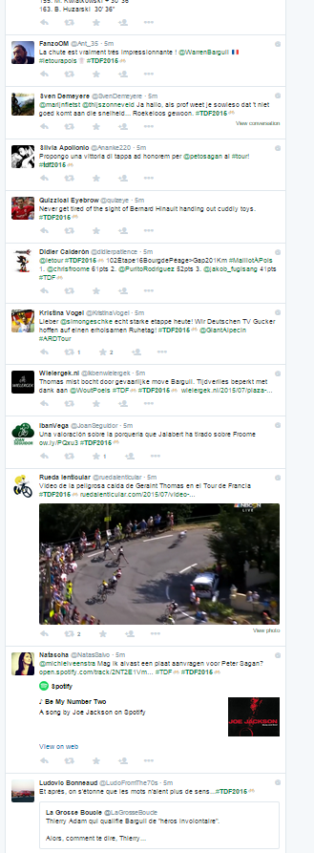
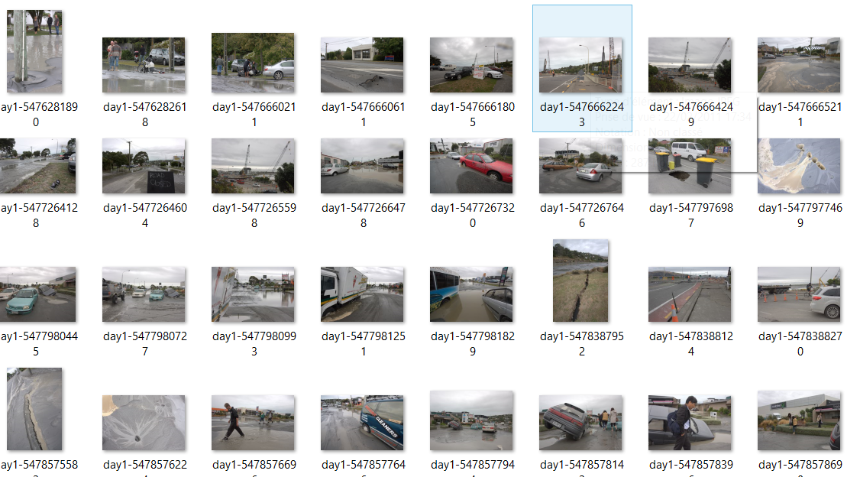
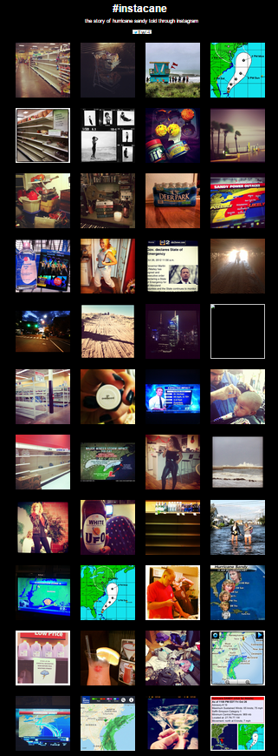
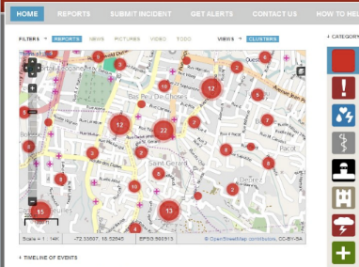
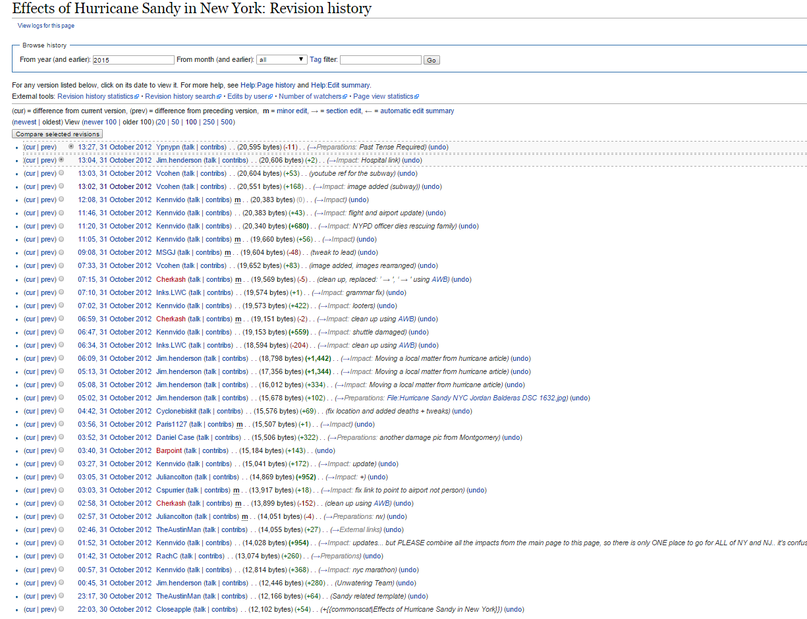
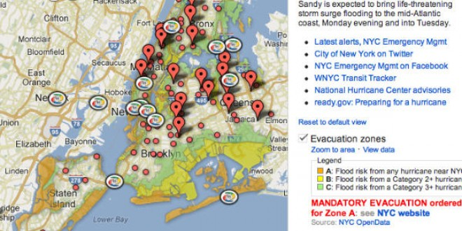
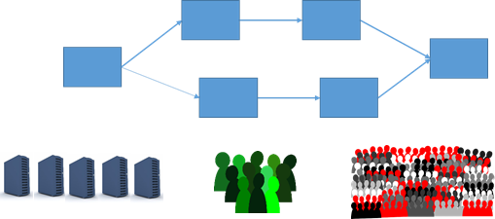
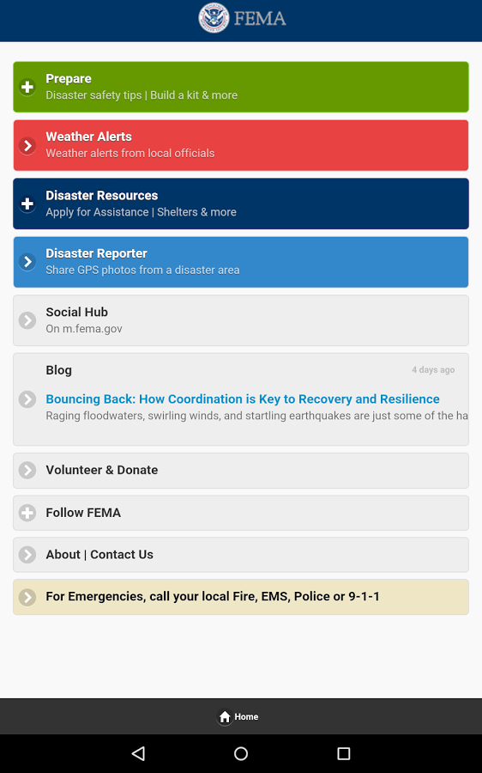
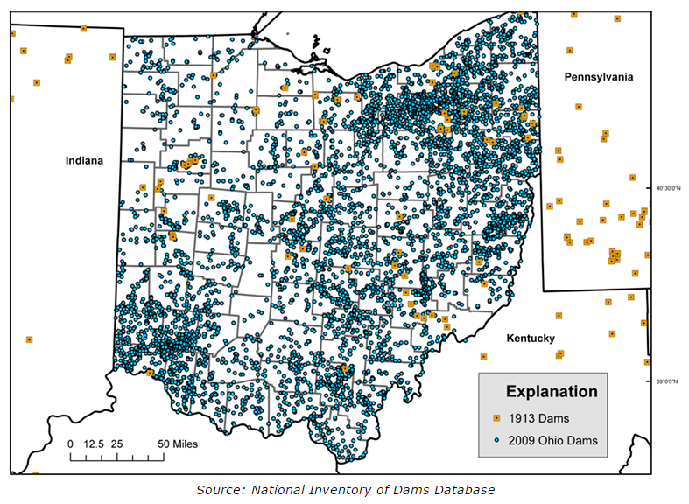
Large scale real time coordination
Unsollicited individual data
Twitter– 35000 geolocalised tweet/day
Flickr – 3000 geolocalised photos/day
10 photos/s
on instagram
during sandy
Collaborative data
Process
Wikipedia 1500 edit to the main page between the 28 and the 30th of october, not mentionning the talk or the area related pages
INPUTS
Citizen Sourcing Data
Dedicated app can receive notification and but used to ask for data
Computers
Crowd
Experts
FEMA dedicated app
How to make the best use of these resources

Slide 50


The Refugee crisis 2015
A very tricky kind of crisis
Affect international relationships
Difficult agreement on the response
Notes:
Still a large and international response of GNO and people (we will come back to it) And still coordination issues. The level of preparedness is not the same in every countries. The goal diverge between countries and organisation. This has a dramatic impact on the first victim of the crisis.

Slide 51



The #refugees response
Instagram stream – 23/9/2015
Twitter stream – 23/9/2015

Slide 52



More recent streams

Slide 53


Citizen initiative
Citizen create Facebook pages to coordinate
Different dimensions and scale
Collect and distribute resources directly

Slide 54


Crowdfunding
Citizen initiative
With or without NGO support

Slide 55

Mapping information about aid initiatives

Slide 56



Slide 57


Mapping of events in Syria

Slide 58


Official vs citizen initiative

Slide 59


Airbnb for refugees

Slide 60
New challenges for Collaboration in crisis management
Fast set up of large scale collaborative network
Coordination at different scales
  People/Organisations
Updating and sharing data at a large scale
  Trust/Privacy issues
Involvement of people/The crowd

Slide 61
Questions ?

Slide 62
Credits
Some slides have been prepared by
  Jorn Franke (Activity management)
  Gérald Oster (P2P sharing)
  Claudia Ignat (Collaborative Editing)

